Slide 1
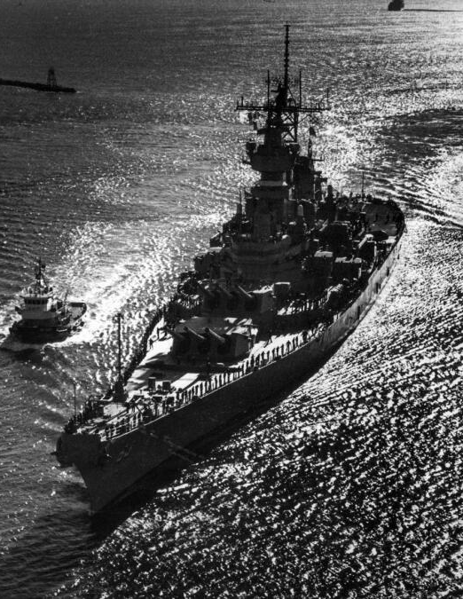
“ BattleShip “
CMPS 270 Term Project
Crew Mates:
Carl El Helayel
Rayyan Youssef Kombargi
Ahmad Chreif
Housni Antar

Slide 2
Table of contents
01
02
03
04
05
High level description
&
Strategies used
Issues
Resolutions
Limitations
Assumptions

Slide 3
High Description
&
Strategies Used

Slide 4
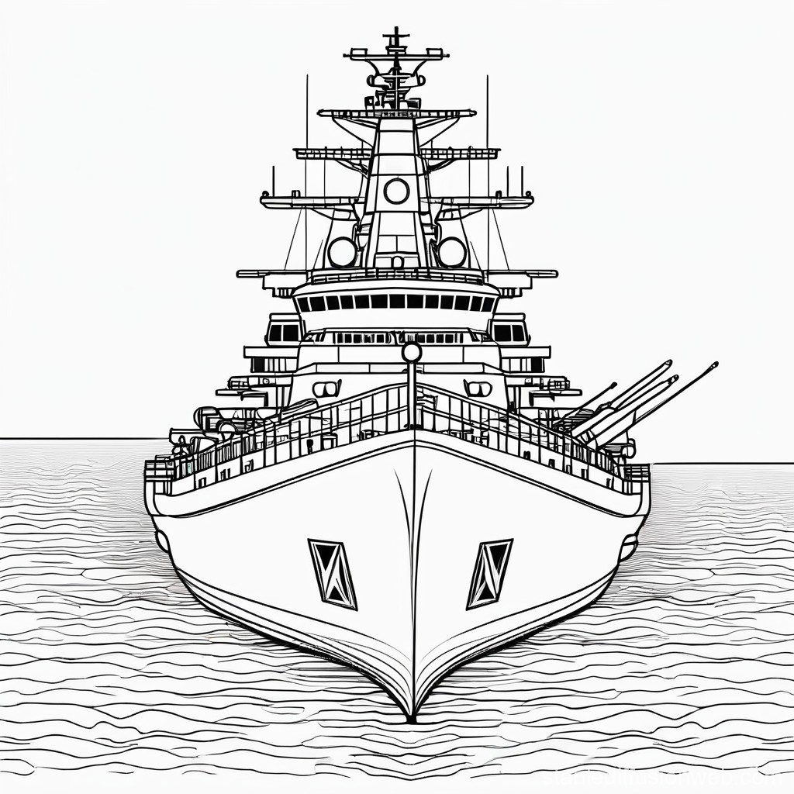
The battleship game is a turn by turn game that is played on a 10x10 grid and the aim of each player is to sink the ships of the opponent/bot by trying to guess the location they should target. In this assignment we also have acquired some special moves like radar sweeps which tells the user if there is a ship in a 2x2 location, smoke screen which hides the users boats from the radar sweeps, artillery and torpedo strikes which target a whole row or column which helps the user to be able to play more strategically.

Slide 5
Game Structure:
The grid starts out as an empty (~) 10x10 grid
Game ends when all the ships are sunk
05
01
04
In the game the players turn alternate after each move (valid or invalid)
The grid tracks the hits (*) and misses (o) depending on the level selected by the user.
02
03
Each player has 4 types of ships of different sizes (5,4,3,2). Ships also have orientation

Slide 6
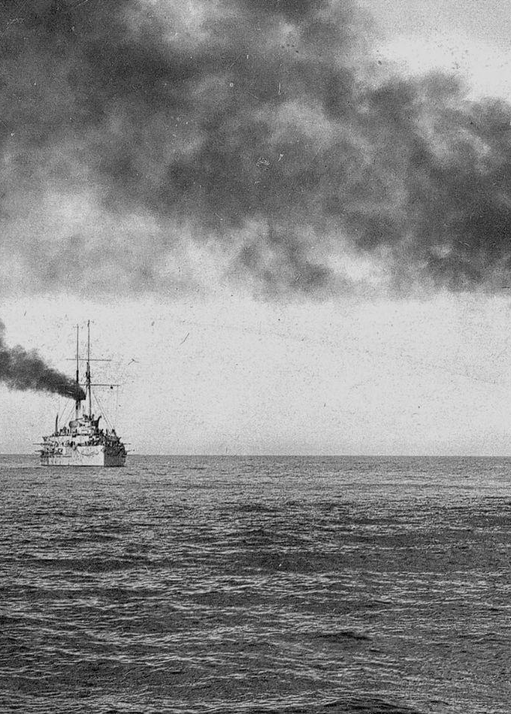
Strategies Used:
Offensive
Defensive
Bot

Slide 7
Offensive Strategies:
Random firing occurs to be able to identify the location of the placed ships
After targeting a ship and hitting it we fire shots adjacent to it (not diagonally)
Artillery targets a 2x2 grid which helps improve the probability of a hit
Torpedo target a whole row or column which is useful for when you want to target a big ship

Slide 8
Defensive Strategies:
1.
2.
3.
Place you ships away from each other to avoid being hit by the Artillery
Avoid placing the ships on the same row or column to avoid the Torpedo
Try using smoke screens to hinder the radar sweeps that the attacker might use

Slide 9
Bot Strategies
1
2
3
Bot starts out with random moves and they also avoid pre targeted areas
Radars are done when there are no recent hits and they focus on unexplored areas on the grid
Once a hit is identified the bot tries to figure out the orientation of the ship and fires accordingly

Slide 10
Issues - Resolution

Slide 11
Phase 1
Location validation and boundary cases to be able to check if the boat is in the correct location
Faced issues with the random turns
Problem with skipping a players turn after using radar whenever the radar was unavailable
Multiple display issues where the grid was not aligned perfectly
Added a function to validate boat placement by checking for overlaps in the 2D array.
Implemented a random turn generator using the current time as a seed.
Created a function to skip a player's turn if their move is invalid, and mark the turn as done if valid.
Fixed the grid alignment by adjusting the for-loop index to ensure proper formatting.

Slide 12
Tried implementing the special moves but constantly got incorrect output
While implementing levels we had problems trying to improve the hits and miss tracking
Problem with smoke screen and how it works
Endgame condition failed to produce the correct output
Successfully implemented methods for each special move, ensuring correct output.
Incorporated a tracking system for hits and misses in the 2D array, adjusting based on the user's difficulty level.
Developed a method to properly implement the smoke screen feature, using a hasSmoke function in the 2D array.
Added a CheckWinCondition method to verify when the last ship is sunk and determine when the game should end.

Slide 13
Phase 2
Faced the issue where the algorithm dedicated for the bot to prompt a move and coordinates was used for the Player’s turn and vice-versa.
Faced the issue where the coordinates of the placed ships which were placed by each player were off the grid.
Initially, we attempted to implement a structure to represent the bot's memory. However, the algorithms associated with this structure failed to ensure the bot could accurately target the coordinates of a detected ship. The memory was intended to store information about the bot's states. For instance, if the bot successfully hit a ship, it would transition to a state where it searches the surrounding area vertically and horizontally before returning to the random firing state.
This was resolved by correcting the conditional logic to ensure the appropriate algorithm is executed for each turn.
Adjustments were made to the ship placement algorithm, ensuring the input coordinates align with valid grid locations.
The memory structure was replaced with a more effective BotState system, which utilizes the player's grid to verify the presence of ships at specified coordinates and their adjacent cells.

Slide 14
We encountered an issue with the radar memory implementation, where we attempted to enable the bot to remember the locations it had scanned with the radar and record whether a ship was detected in those areas.
The bot's targeting logic struggled to perform better than random firing, limiting its strategic capabilities.
The radar memory concept was ultimately scrapped due to its inefficiency
Enhanced the bot's logic by integrating pattern recognition in its BotState, enabling it to prioritize high-probability targets based on past hits and misses. Additionally, state-based transitions were improved to optimize targeting during focused search or radar-assisted moves

Slide 15
.
The large number of lines in phase 2 proved to be a setback as we struggled to navigate through the code
In phase 2, one of the key improvements wasn't in the gameplay strategies but in how we structured and organized our code. We transitioned from a large, monolithic program to a more manageable and organized codebase by separating the code into relevant header (.h) and source (.c) files based on their functionality. While this change might seem minor in terms of gameplay output, it greatly enhanced the clarity, readability, and overall structure of our code. This organization made it much easier to navigate the code, locate specific components, and work more efficiently, ultimately improving our ability to debug and enhance the program.

Slide 16
Limitations

Slide 17
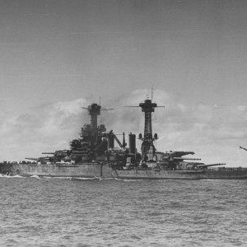
We were unable to implement a method for the bot to strategically decide when to use the radar move. Currently, the bot is restricted to using radar moves only at the beginning of the match, before any ships have been located.
The torpedo and artillery moves are triggered exclusively when the bot has detected the location of a ship based on a pre-designated priority.
The bot does not utilize smoke moves. Implementing this functionality would require additional algorithms to determine when to deploy smoke, such as when some of its ships are under threat or have started to be eliminated and could prove to be inefficient in our BattleShip bot.

Slide 18
Assumptions

Slide 19
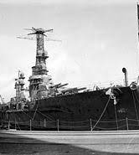
Fixed Grid Size and Ship Placement:
The game uses a fixed 10x10 grid. Ship placements are assumed to be valid and non-overlapping, however our program handles edge cases where input is invalid.

Slide 20
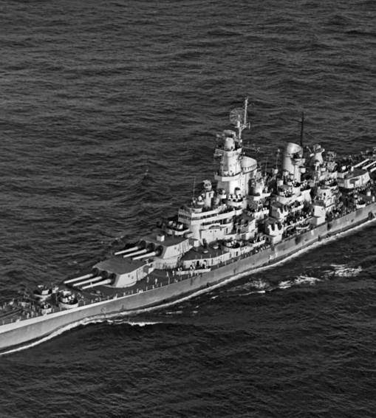
Player and Bot Turn Logic:
The program alternates between the player’s turn and the bot’s turn. The logic for prompting moves and coordinates for each turn is handled by separate algorithms to ensure they are not swapped.
The bot's move algorithm is designed to select random targets initially, transitioning to a more focused strategy after hitting a ship.

Slide 21
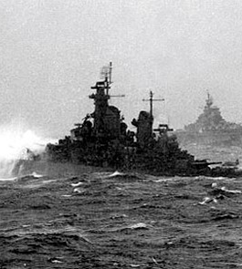
Bot Memory and State Management:
The bot uses a state-based logic (represented by the BotState struct) to track hits, misses, and the status of nearby grid cells.
The bot will switch between random firing and targeted attacks based on the results of previous moves, ensuring that it adapts to the game state.
The bot cannot make decisions beyond the predefined strategies (e.g., the bot doesn't decide when to use radar more than once beyond the start of the game).
The bot does not adapt or improve its strategy over time based on player actions. The bot’s logic remains fixed throughout the game, and it does not use advanced machine learning techniques to improve its decision-making.

Slide 22
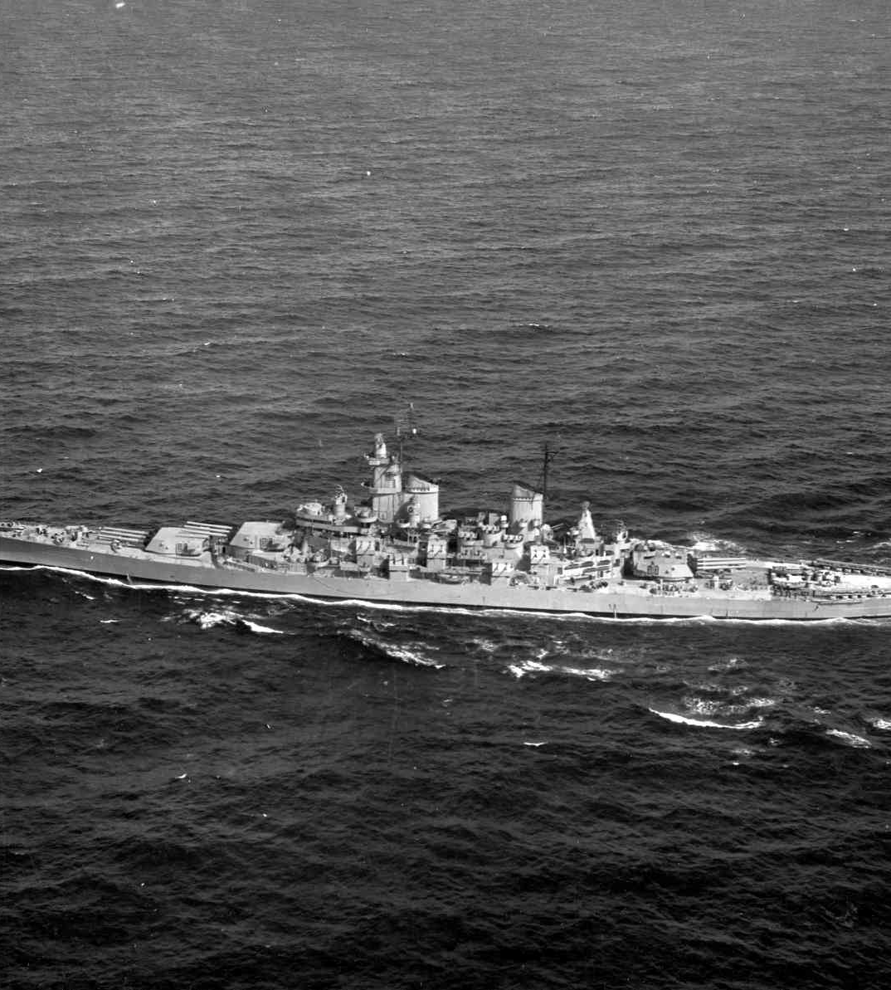
Special Abilities (Radar, Artillery, Torpedo):
Special abilities like radar, artillery, and torpedoes are used based on the bot’s state. The radar move is restricted to the start of the match when no ships have been found yet.
Artillery and torpedoes are only used when the bot detects the location of a ship.
The bot does not utilize smoke moves, as implementing such functionality would require additional logic to determine when to deploy smoke effectively, such as when its ships are under threat.

Slide 23
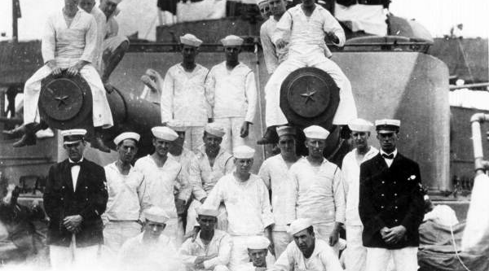
Us on a BattleShip

Slide 24
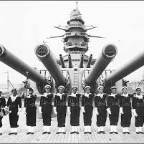
Thank You Sailors!
Please aboard the deck

